Slide 2
National Traffic System Handling Formal Messages
Emergency Communications Workshop
2

Slide 3
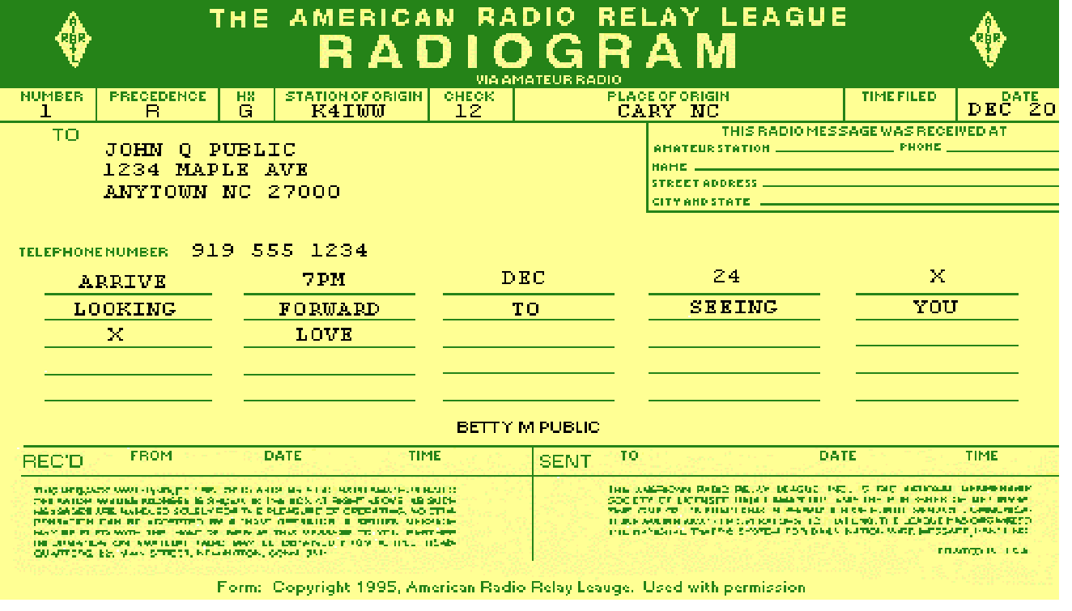
Radiogram Format
3/5/2011
Emergency Communications Workshop
3

Slide 4
Formal Written vs. Tactical Messages
Most emergency traffic is tactical
Formal written traffic is important for:
A record of what has happened —
Ability to track
Use when relays are required in order to keep messages intact
Use of radiogram unless other formats such as ICS-213 or agency formats are required
Emergency Communications Workshop
4
Notes:
Organization, sending ops here or there, different frequencies

Slide 5
Radiogram Preamble: Precedence
Precedence is R, W, P or EMERGENCY
Emergency [Never Abbreviated]
life and death urgency, officially designated
P - Priority
other official or urgent / time sensitive
W - Health and Welfare
outgoing: advisory all is well etc.
incoming: inquiry as to H&W of someone.
R - Routine
Emergency Communications Workshop
5

Slide 6
Radiogram Contents Preamble
Number (1,…)
Precedence (R, W, P or EMERGENCY)
Handling Instructions (HXA…HXG)
Station of Origin (your call sign if you originated it)
Check (count of number of words/groups in body text)
Place of Origin (where sent from)
Date (Time/Date) Filed, Time zone
Emergency Communications Workshop
6

Slide 7
Radiogram Preamble: Handling Instructions
Handling Instructions (optional,)
HXA(#)—Collect miles
HXB#—Cancel hours
HXC—Report TOD
HXD—Trace
HXE—get reply
HXF#—Hold until #date
HXG—Free delivery only
Emergency Communications Workshop
7

Slide 8
Radiogram Contents The Rest
Address as complete as possible
Text (Body)
Separate from Address with break (BT)
Limit to 25 words or less, if possible.
Use X for punctuation between sentences but not at end
Signature
Separate from Text with break (BT)
Name
Phone number suggested for reply addressing
Operators Notes (Optional)
Separate from Signature with break (BT)
Emergency Communications Workshop
8

Slide 9
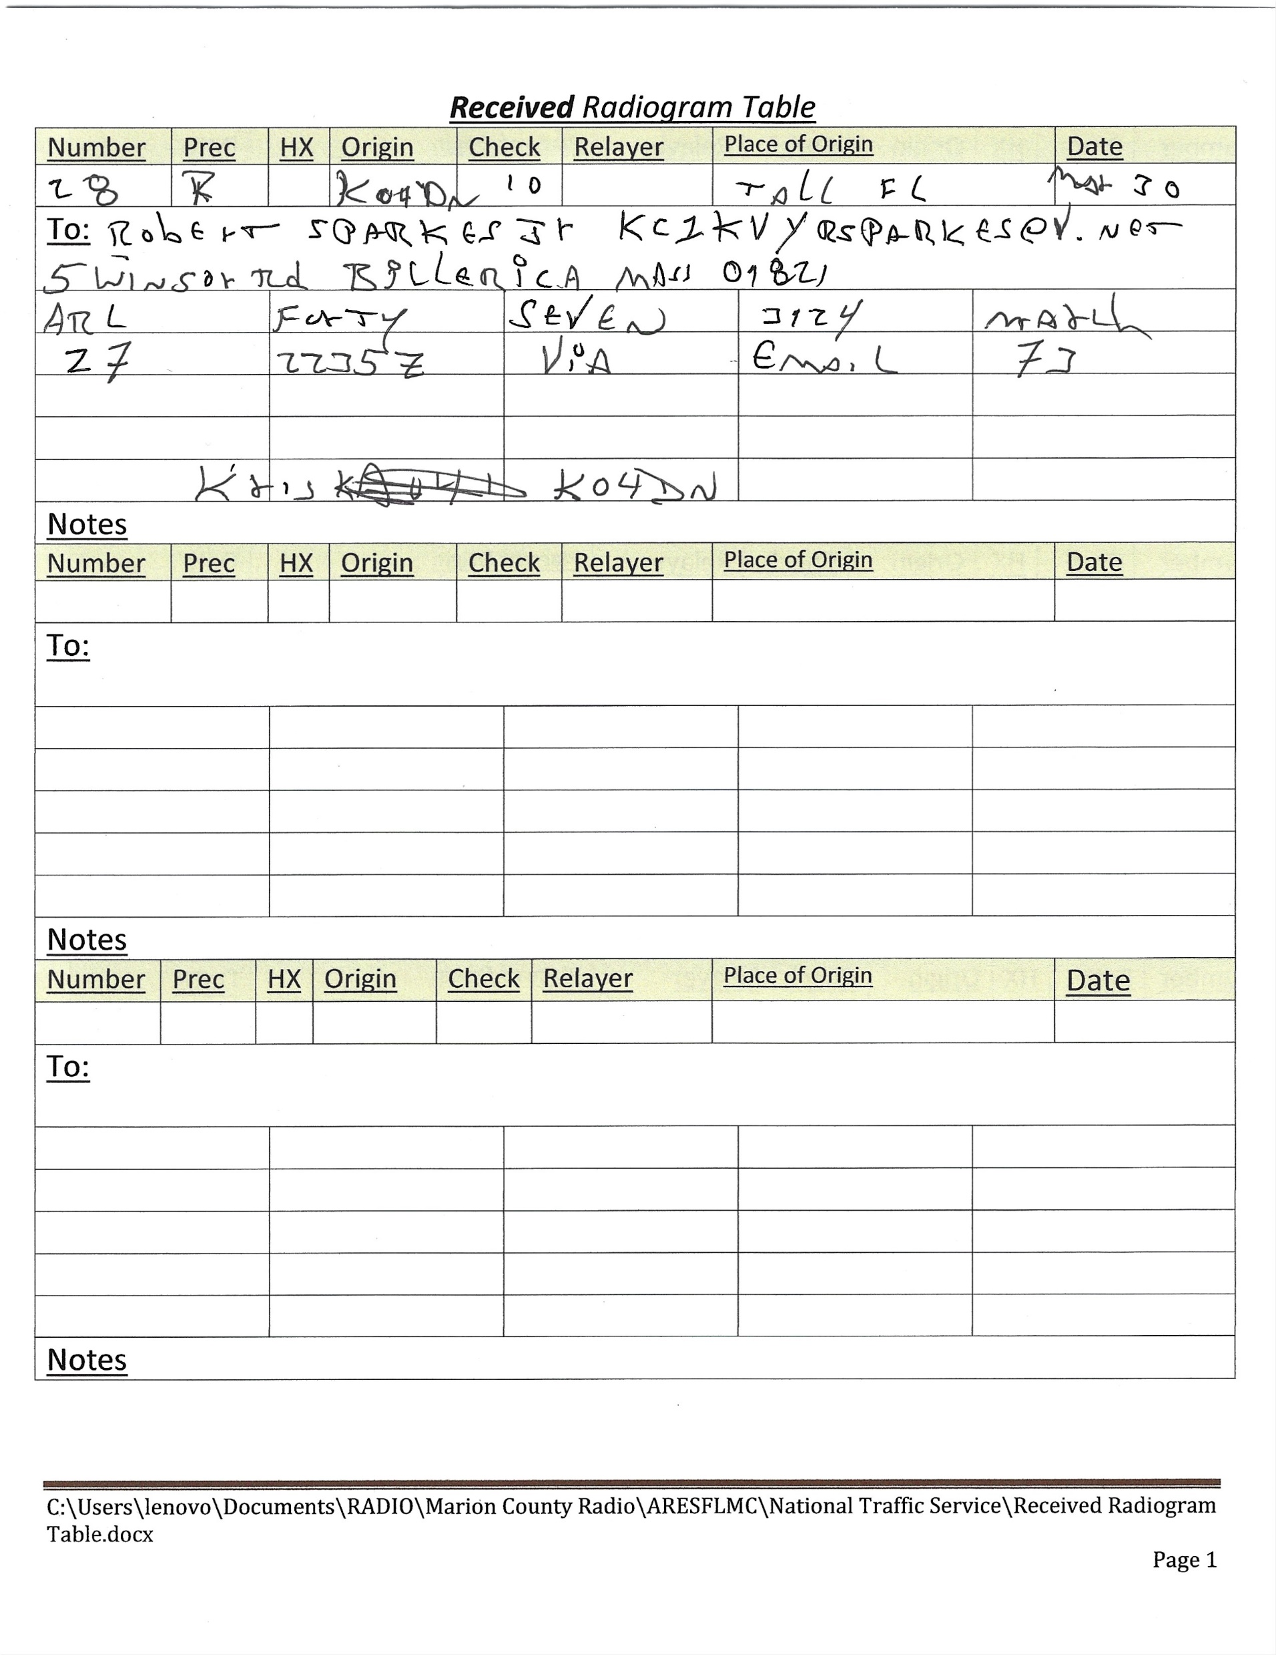
This is how it starts.
Just write it down.
This what this session
sounded like on HF.

Slide 10
ARRL Numbered Radiograms
FORTY SEVEN Reference your message number _____ to _____ delivered on _____ at _____ UTC.

Slide 11
Now I want to turn this Numbered Message into a meaningful script
Good day Robert KC1KVY,
Ko4dn has relayed this message by radio from Tallahassee, Fl
to you.
Message:
Referencing your message number 3124 was delivered on March 27 2234 UTC
via email.
73,
Kris ko4dn
For the Marion County Traffic Net
For the Florida Phone Traffic Net
Gray Moffett KC3DWY
Assistant Emergency Coordinator
Marion County Amateur Radio Emergency Service
www.aresmcfl.org

Slide 12
Pro-Words
Figure – single numeral follows
Figures – several numerals follow
Letter Group – usually an abbreviation (EOC)
Mixed Group – letters and numerals (12A)
Amateur Call – special type of mixed group
I Spell – phonetic spelling follows
I Say Again – repeat of previous word
Emergency Communications Workshop
12

Slide 13
Pro-Words (2)
Correction – I’m going to correct something
End – end of message
More – additional message(s) follow
No more – no additional messages
Say Again – request from recipient to repeat
Word after
Word before
All after
All before
Between
Emergency Communications Workshop
13

Slide 14
If Check Doesn’t Match
Clarify special items, e.g., email address is 5 words
Read message at reading speed stopping after every 5 words so recipients can identify where count is off or read every fifth word
Note discrepancy in count in optional Operator’s Notes
Emergency Communications Workshop
14

Slide 15
Radiogram: “Properly Serviced”
For a message to be “properly serviced” and thus traceable, record how it traveled. This may be in your traffic log or on an actual Radiogram form for each message.
Received from another station
For all messages except those originated, record
Received From: Station, date, time received from.
If relaying to another station
Sent To: Station, date, time relayed
If delivering hard-copy to addressee,
Received At: Your call, phone, name address
Send Reply to sender or Service message to Originator
Emergency Communications Workshop
15
Notes:
Slide 6

Slide 16
IMPORTANT
Goal is to get the message through intact!
From the ARRL NTS Methods and Practices Guidelines – MPG. Do what the trained receiving operator expects and confusion and errors will be minimized
Emergency Communications Workshop
16

Slide 17
NTS Net Schedule
NTS Net Schedule and also where to send NTS messages via Packet.
Check out the NTS web site at ema.arrl.org/national-traffic-system/ for updates on NTS and the net schedule.
Net | Time | Frequency | Mode | Net Manager
EM2MN | 8:00 PM | 145.23- PL: 88.5 | FM | Peter –KC1HHO
CM2MN | 9:00 PM | 146.97- PL: 114.8 | FM | John-KK1X
HHTN | 10:00 PM SuMWF | MMRA System PL: 146.2 | FM | Joe-W1HAI
CITN | 7:30 PM TuThFSa | 147.375- PL: 110.9 | FM | Mark-AC7RB
MARIPN | 5:00 PM M-Sa | 3.978 MHz | LSB | Ralph-N1LAH
MARI | 7:00 PM | 3.565 MHz | CW | Marcia-KW1U
MARISN | 8:30 PM MTuFSa | 3.598 MHz | CW | Rob-K2MZ
17

Slide 18
Traffic Nets Cont.
Region Nets
FRN 3.950 Khz SSB 2:45 & 4:15 PM (during Daylight Savings Time)
1RN 3.598 Khz CW 7:45 & 9:30 PM
Digital
KW1U MBO 24/7 VHF Packet 145.090 Mhz & HF Pactor (scanning multiple frequencies. See kw1u@arrl.net for further information)
Winlink via kw1u@winlink.org

Slide 19
Resources
ema.arrl.org/national-traffic-system/
Check NTS Resources under Quick Links
Includes fillable Radiogram form, ITU Phonetics, etc.
winlink.org
arrl.org Methods and Practices Guidelines (MPG)
From the ARRL NTS Methods and Practices Guidelines MPG - Do what the trained receiving operator expects and confusion and errors will be minimized

