Slide 1
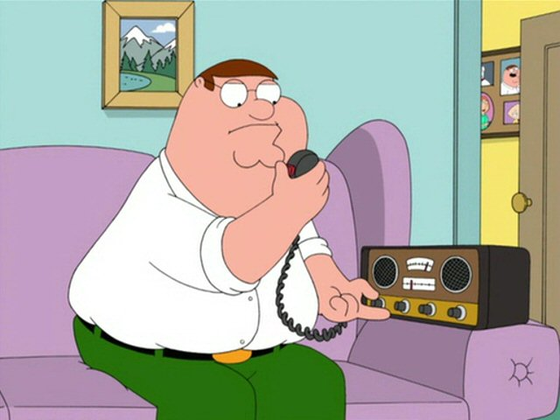
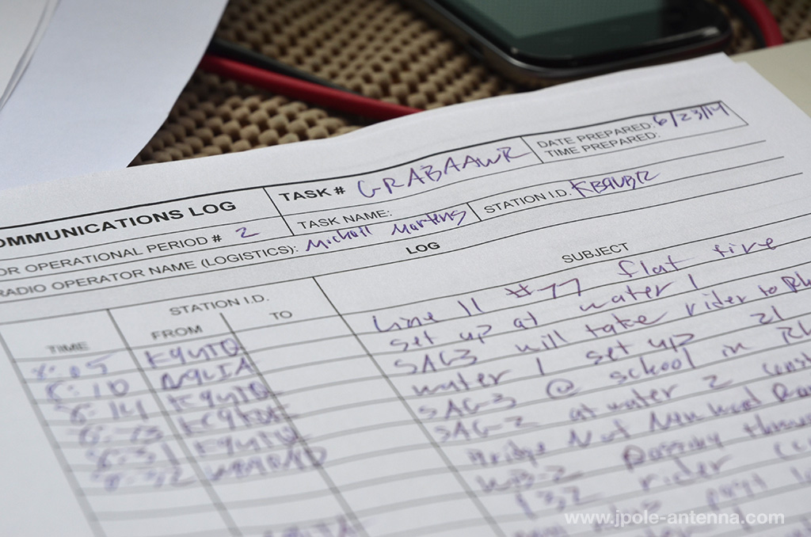

Net Control Operations
Presented by Hayden Kaufman N2HAY/NNA4GC
EC, Marion County Amateur Radio Emergency Service

Slide 2

What’s on Tap Today?
Nets
Why do I want to be Net Control?
Emergency Net Activation
What’s Needed to be an NCS?
Scripted Nets (A Trip to the Web)
The Shift Change
The Status Check
Closing an Amateur Radio Net
Things You Need to Practice

Slide 3
What’s a net, anyway?
The word "net" is short for "network".
Networks can be defined as groups of equipment, individuals, and/or agencies acting together to increase efficiency and effectiveness through shared information and resources.
The word "network" can be further broken down into its two components.
"Net" implies a capture and holding effect.
"Work" implies that something productive is to be accomplished.

Slide 4
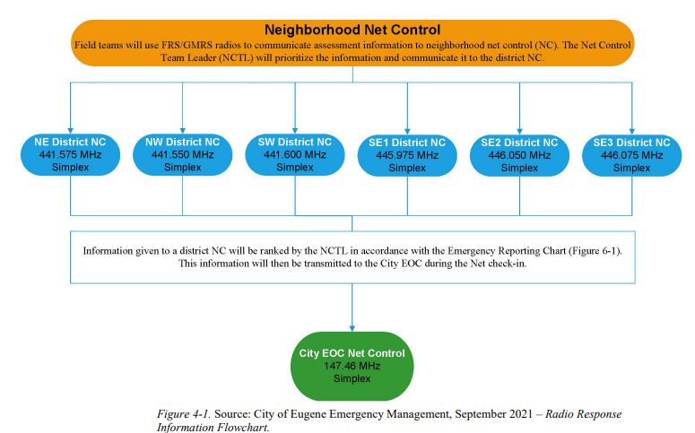

Slide 5
Therefore...
So.…
Ham radio operators and nets in emergency a situation capture, record, hold, and distribute information so that others may work (produce results) more effectively.

Slide 6
DIRECTED NETS
Formal (has a set of rules or net directives, and all communications must go through net control)
Controlled by NCS (controls the frequency with net related traffic only. The NCS will issue specific instructions on how he/she wants the net to run.)
Must obtain permission from the NCS before transmitting to other stations in the net.

Slide 7
DIRECTED NETS (cont’d)
SCHEDULED NET
Most scheduled nets are directed.
ARES, CERT, RACES, SkyWarn
Club or Organization Net

Slide 8
EMERGENCY Nets
"Emergency" may be defined as an accident or other crisis where people and/or property are in distress.
Emergencies are nearly always recognized and declared by agencies or authorities outside of the Amateur Radio Service.
Amateur radio operators and net control stations do not have independent authority to declare an emergency*

Slide 9

Southern Peninsula Emergency Communications System (CA)
1989 Loma Prieta Earthquake
“I started the tape about 10 minutes after the main event. Seconds before I
pushed record, we had a Mag 5x aftershock. If you listen closely, you can
hear my neighbor's alarm sounding in the background. There were several
more aftershocks that happened during the taping. One knocked my phone
off the hook. You can hear the alert beeps. One aftershock interrupted the net
due to net control having to leave the Sunnyvale Fire Station he was in. I pulled
out my generator at dusk and we had the whole neighborhood at our house
watching the news. We were without PG&E Power for 3 days after the event!
The night of the quake around 11:00pm, I was called to open a Red Cross
Shelter at the Senior Center in Mountain View. I checked people in all night,
but in the morning the city condemned the building due to damage. We moved
the shelter to the Rengstorff Park Recreation Center where I finished my shift.”
~ de Eric N6OIM
http://n6oim.com/loma/loma1.mp3 http://n6oim.com/loma/loma2.mp3

Slide 10
More on emergency nets
An Emergency Net is a group of stations who provide communication to one or more served agencies or to the general public in an emergency.
Emergency nets may have different purposes and a given emergency may require one or more of these types of net. During a small operation, all functions may be combined into one net.
SkyWarn and ARES are examples of emergency nets. Tactical, Command, Resource and Information nets are types of emergency functions used during an Emergency Net.

Slide 11
Why do I want to be Net Control?
The updated national ARES Taskbook states that any member wishing to attain level 2 or 3 certification is required to act as NCS at least once per year and is suggested to act as NCS once per quarter (where feasable.)
As a rule, any NCS station for a weekly scheduled net is responsible for bringing up a net in the event of an emergency during their NCS “on-duty” week.

Slide 12
Why Me?
Being NCO for a Club net or any other regularly scheduled non-EMCOMM net gives you practice from the “other side of the mic” and helps foster a respect for the rules of a directed net.
Running informal nets such as roundtables helps with the general movement of conversation and gives a sense of order to what can very easily become chaos.

Slide 13
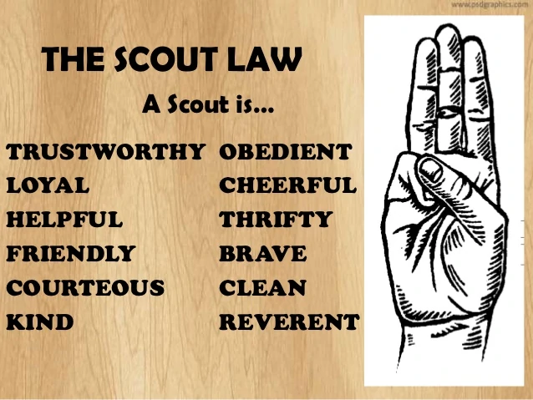
Traits of a good NCO
Does anyone remember the Boy Scout Law?

Slide 14
What It Takes!
Well, a good NCO is…
A good communicator with consistent skills and fluent command of our language
Someone with good voice quality
Someone with good hearing capabilities
Someone with good listening capabilities
Someone with good ear-to-hand copying skills
Someone who understands what SERVICE means
Someone who has good knowledge of the Incident Command System
Someone who is willing to take and carry out direct orders
A strong team player
Self-assured but not overbearing
Decisive, with the maturity to make good judgment calls

Slide 15
More of What It Takes!
A good NCO also needs to be...
Physically able to tolerate high stress for extended periods
Constantly concerned for the safety of participants
A good organizer
Able to absorb new terminologies quickly
Generally neat of appearance
Someone who consistently demonstrates above average operating techniques

Slide 16
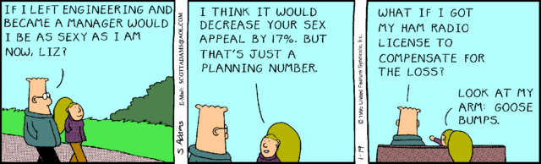
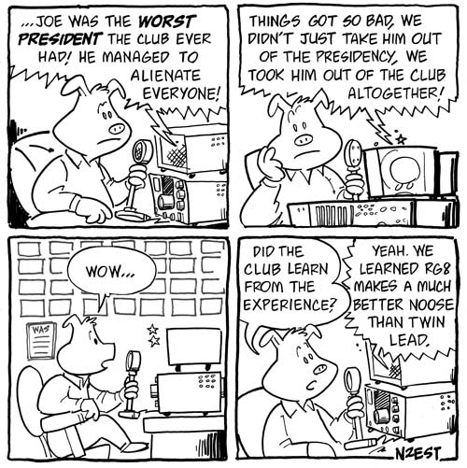
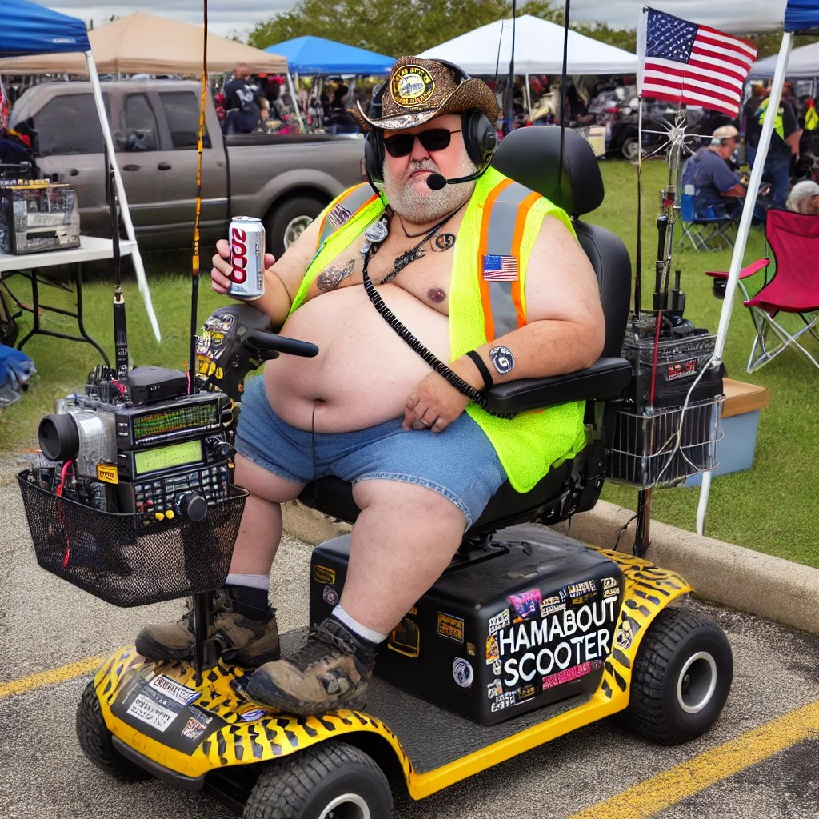
LAUGH!
HAVE A GOOD SENSE OF HUMOR!

Slide 17







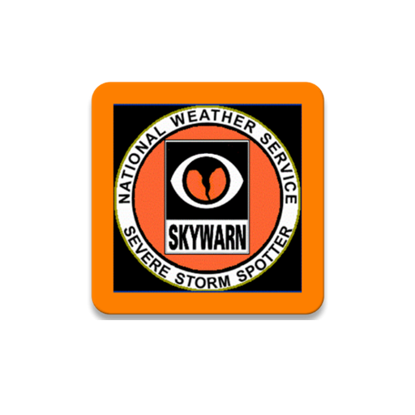



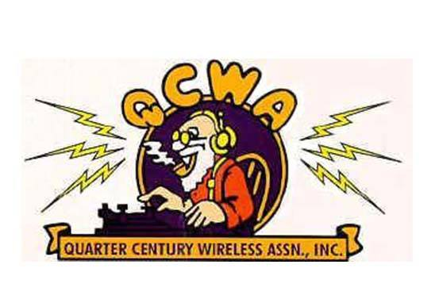
Served Agencies

Slide 18
Long Nets - The Shift Change
Responsibilities of Incoming NCO
  Arrive 10 - 15 minutes prior to assigned shift
  Review standard net procedures and job aids
  Verify supplies you will need and make arrangements for replenishment if necessary
  Observe message handling procedures being used and note any questions
  Review all logs for an overview of current status

Slide 19
The Shift Change (cont.)
Responsibilities of Outgoing NCO
  Show incoming NCO where key documents are located
    Mobilization/Demobilization Log
    Event Log
    Net Control Message Logs

Slide 20
The Shift Change (cont.)
Responsibilities of Outgoing NCO (cont.)
  Brief incoming NCO on the current operation
    Review nature of activity in field
    Identify messages which are awaiting action/reply

Slide 21
The Shift Change (cont.)
Responsibilities of Outgoing NCO (cont.)
  Verify incoming NCO understands the message handling procedures in use
  Advise incoming NCO of any problems or unusual activity which has occurred on your shift and how they were dealt with
  Introduce incoming NCO to the local manager, if one is present

Slide 22
The Shift Change (cont.)
Responsibilities of Incoming and Outgoing NCOs
  When both satisfied that they are ready to change control:
      Contact Command Net and advise of call sign of incoming NCO and status of outgoing NCO
  Outgoing NCO should contact Resource Net to advise of status and destination

Slide 23
The Status Check
All operators must be accounted for on a regular basis, approximately every fifteen minutes to half an hour when possible.
Announce you will be performing a status roll call.
Perform the roll call and record status of each operator.
Contact Command Net with short status of net and a report that all operators are accounted for.

Slide 24
Net Announcements… A Good Idea!
Safety reminders
Frequencies of Sub-Nets and Liaison Stations
Current events regarding the emergency.
Short term weather forecasts
Encouragement and praise to the poor guys standing in the rain, etc.
Shift Schedules
Eating Schedules and Food Source Locations
Short break relief rotations

Slide 25
Net Announcements… A Good Idea!
Locations of restrooms available
Travel/transportation hazards and safe travel routes
Termination/Activation of emergency sub-activities
Humorous happenings
Equipment/battery check
ID sessions
Relays of personal messages from family to participant

Slide 26
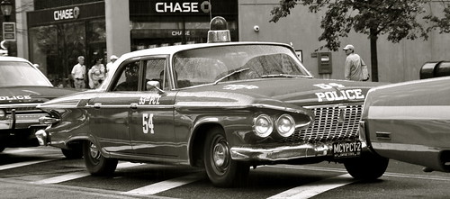
Hello? HELLO?! Where Are You?
What to do if an operator fails to respond to the status check
  Call station again
    If no response, move on to other operators and come back at end of roll call and make two attempts to contact the operator
  If no contact, immediately notify Command Net and provide the call sign, current assignment, and last know location (and destination if mobile)
  If station is known high-risk or possibly endangered, be sure to inform Command Net.

Slide 27
Closing Time…
Announce net will be closing
Contact operators with continuing assignments, advise of new net frequency, check operators out
Advise remaining operators of procedures to be used upon release
Conduct closing roll call
Announce net is closed
Contact Command Net
Return all net-related paperwork or file reports online

Slide 28
Practice, practice, practice!
Copying Call Signs
  Ear-to-hand coordination difficult to master
  Ask for slow pace and space between check-ins
  Listen how contesters/DXers handle pile-ups
Writing it Down
  NCO is always writing something down
  Practice taking notes listening to a net
  Plan and train for worst case scenario

Slide 29
Things You Need to Practice (cont.)
Practice Listening
  Train your hearing to sort out the messages from the noise
  Try to make sense out of that “bad” signal
  Listen to any conversation on HF during distant weather disturbances
Practice Running Nets
  Run local rag chew net, ARES/RACES net, Skywarn net, club net, etc.
  Tape record any net you run – you will be your own worst critic

Slide 30
THAT GUY… UGH.
This is one of the toughest things you are going to face. If handled incorrectly, it can cause net participants to "take sides" and erode the morale and effectiveness of your net. People get their feelings hurt over nothing, especially when they are tired and under unusual, stressful circumstances. Your first reaction may well be to retaliate in an upset manner. This will blow the net. Here is a formula to cure the problem:
1. Slow up. Don't respond instantly. Take a deep breath.
2. Do a quick personality review of your assailant.
DO THE NEXT THREE STEPS ALL IN ONE STATEMENT.
3. Acknowledge the problem. Give in to the "Problem," whether they are right or wrong! This acknowledges that there is a problem and that you are recognizing that fact. It also throws them off balance. They are not expecting this. Once you agree that there is a problem, the "fight" is gone.
4. Empathize with them! Whether you understand or not, tell them that you can understand how they can feel that way and that under the same circumstances, you would probably feel the same way.
5. Ask them for a quick and simple suggestion for a solution.

Slide 31
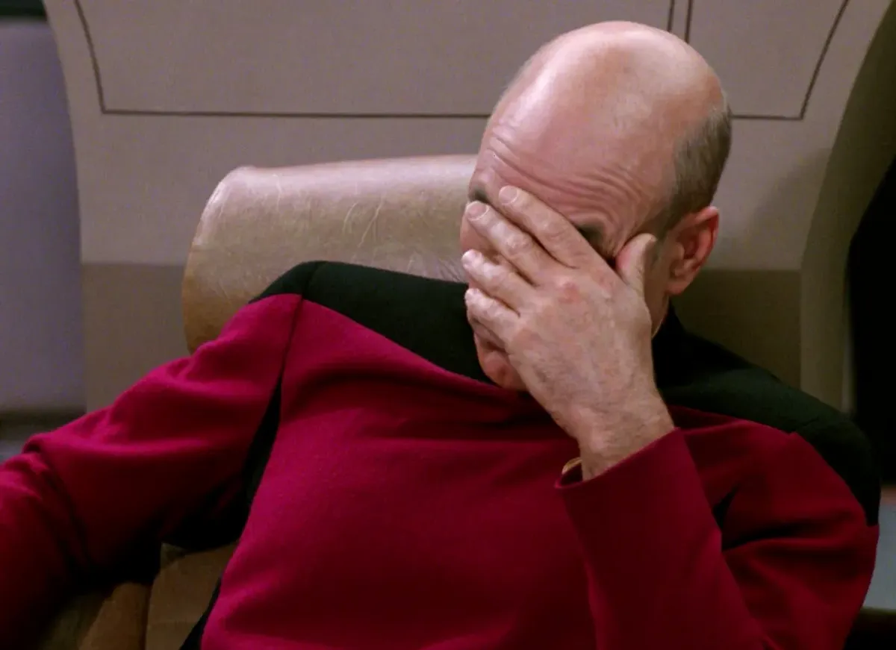
Oy, THIS GUY...
Listen intently! This is where they will reveal the real problem. Everything they have said up to now may have been a loud smokescreen. Somewhere in their suggestion, they will tell you what they really want from you.
If their suggestion/solution is something reasonable, tell them that you will try to put it into play. If it is not, make a counter-suggestion that will satisfy the real problem that they have revealed to you.
If the problem cannot be resolved quickly and reasonably, quietly send someone to replace this individual and relieve him from his post. If there are no posts involved in the operation, give up - let him win - politely explain that the net must continue, thank the person for his services, and tell him he doesn't have to stick around. You tried to solve the problem reasonably and he refused.
He wins the fight and you’ve won the battle.
The rest of the net will respect what you did and morale will remain intact.

Slide 32
Oh, yeah… Prowords!
Voice Net Prowords:
• OVER – I have finished talking, your turn (good for simplex)
• ROGER – Message understood
• COPY THAT – See Roger
• STANDING BY – I am awaiting further transmissions
• OUT – This communication is concluded
• WILCO – I understand and will comply
• OFF the AIR – Self explanatory
• BREAK – I have further communication or I want to talk
Message Handling Prowords – for repeating traffic:
• WORD AFTER “Say again word after…”
• WORD BEFORE “Say again word before…”
• BETWEEN “Say again between…and…”
• ALL AFTER “Say again all after…”
• ALL BEFORE “Say again all before…”

Slide 33

Field NCS Kit
Clipboard
Note pad
ICS Forms and Logs
Pens
Pencils
Box paper clips
Stapler
Time and Date Stamp (if desired)

Slide 34
A Cute Little Trick
Personal Identifier (if desired)
- It’s been my experience that a personal identifier, such as a stamp, symbol or personalized punch can make a difference in a paperwork shuffle.
Railroad conductors have a unique punch assigned to them so that documents can be identified later on if an audit is required.

Slide 35


Slide 36
Giving Credit Where Credit is Due
Even though we’re finished with the formal training, there is one point that I would like to make to each and every one of you.
We’re ALL volunteers. We’re ALL giving of ourselves to assist others.
Be sure to thank your operators, whether it be for their check-ins, their reports, or just for being part of your net. Do it as you close a net, do it as they secure, heck, you can even send a Radiogram or a note via Winlink or e-mail. Just THANK them.
Thank you for attending and paying attention. Now, let’s see what you learned!
Special thanks to K8AMR, KE4QDM, KC8WSK and KD8AMR from Idaho ARES/RACES for compiling content and their indirect guidance and inspiration to prepare and present this course.

